Slide 1

Telecom Churn Analysis — California
Data-driven review of 7,043 customer records uncovering a 26.54% churn rate and $3.68M revenue loss. Presented by J. Vijay — Business Analytics.

Slide 2




Dataset & Scope
Records
7,043 rows · 38 columns
Geography
Customers located in California, USA
Key Categories
Demographics, Services, Account Info, Churn Data

Slide 3


Data Cleaning & Standardization
Used Oracle SQL to clean and standardize records.
Updated 1,527 null service entries to "No" for customers without internet.
Mapped cities to correct lat/long values for California.
Replaced NULL CHURN_REASON for active customers with "Active Customer".
Binned age into 19–39, 40–59, 60–80 for demographic analysis.

Slide 4

Exploratory Data Analysis (EDA)
Identified churn patterns by service, contract, age, and geography to explain the $3.68M revenue impact.

Slide 5







Support & Contract Signals
Premium Tech Support
Churners with support: 186 vs. without: 1,050 — strong retention driver.
Month-to-Month Risk
Month-to-month contracts, especially Fiber Optic users, show highest churn (1,107 churners).

Slide 6
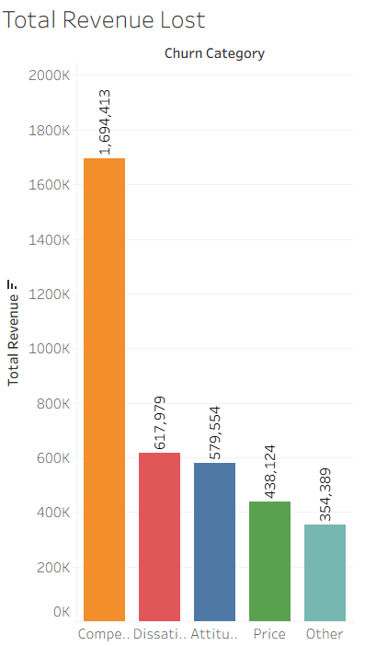
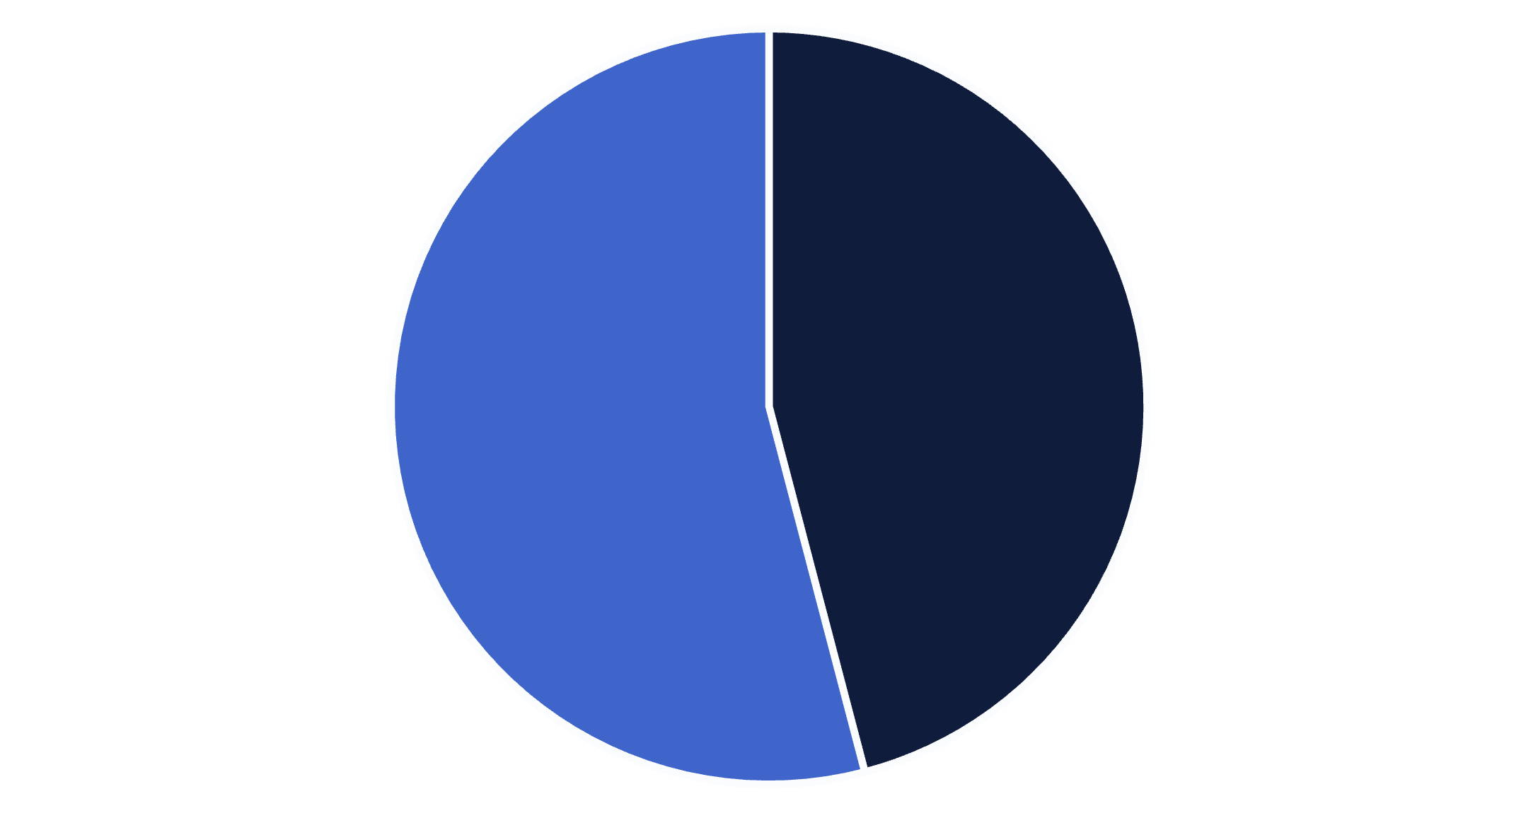

Revenue Leakage — Competitor Impact
$1.69M (≈46% of $3.68M) lost to competitors — the single largest revenue threat. Focus required on pricing and bundles.
Competitors
Other

Slide 7

Age-Driven Findings
286
1107
186
Senior (60–80): Highest churn volume due to competitor offers.
Month-to-month Fiber churners: Primary high-risk group (1,107).
Customers with Premium Tech Support: Low churn count (186).

Slide 8

Recommendations — Targeted Retention
1
2
3
4
1. Premium Support Bundle
2. Competitor Win-Backs
3. Contract Conversion Incentives
4. Geographic Service Audits
Bundle Premium Tech Support with Fiber plans to reduce churn among highest-risk users.
Price-match and loyalty bonuses targeted at Seniors (60–80) to recapture $1.69M lost to competitors.
Perform localized infrastructure and quality audits in California churn hotspots.
Offer discounts to convert month-to-month Fiber users to 1–2 year contracts.

Slide 9
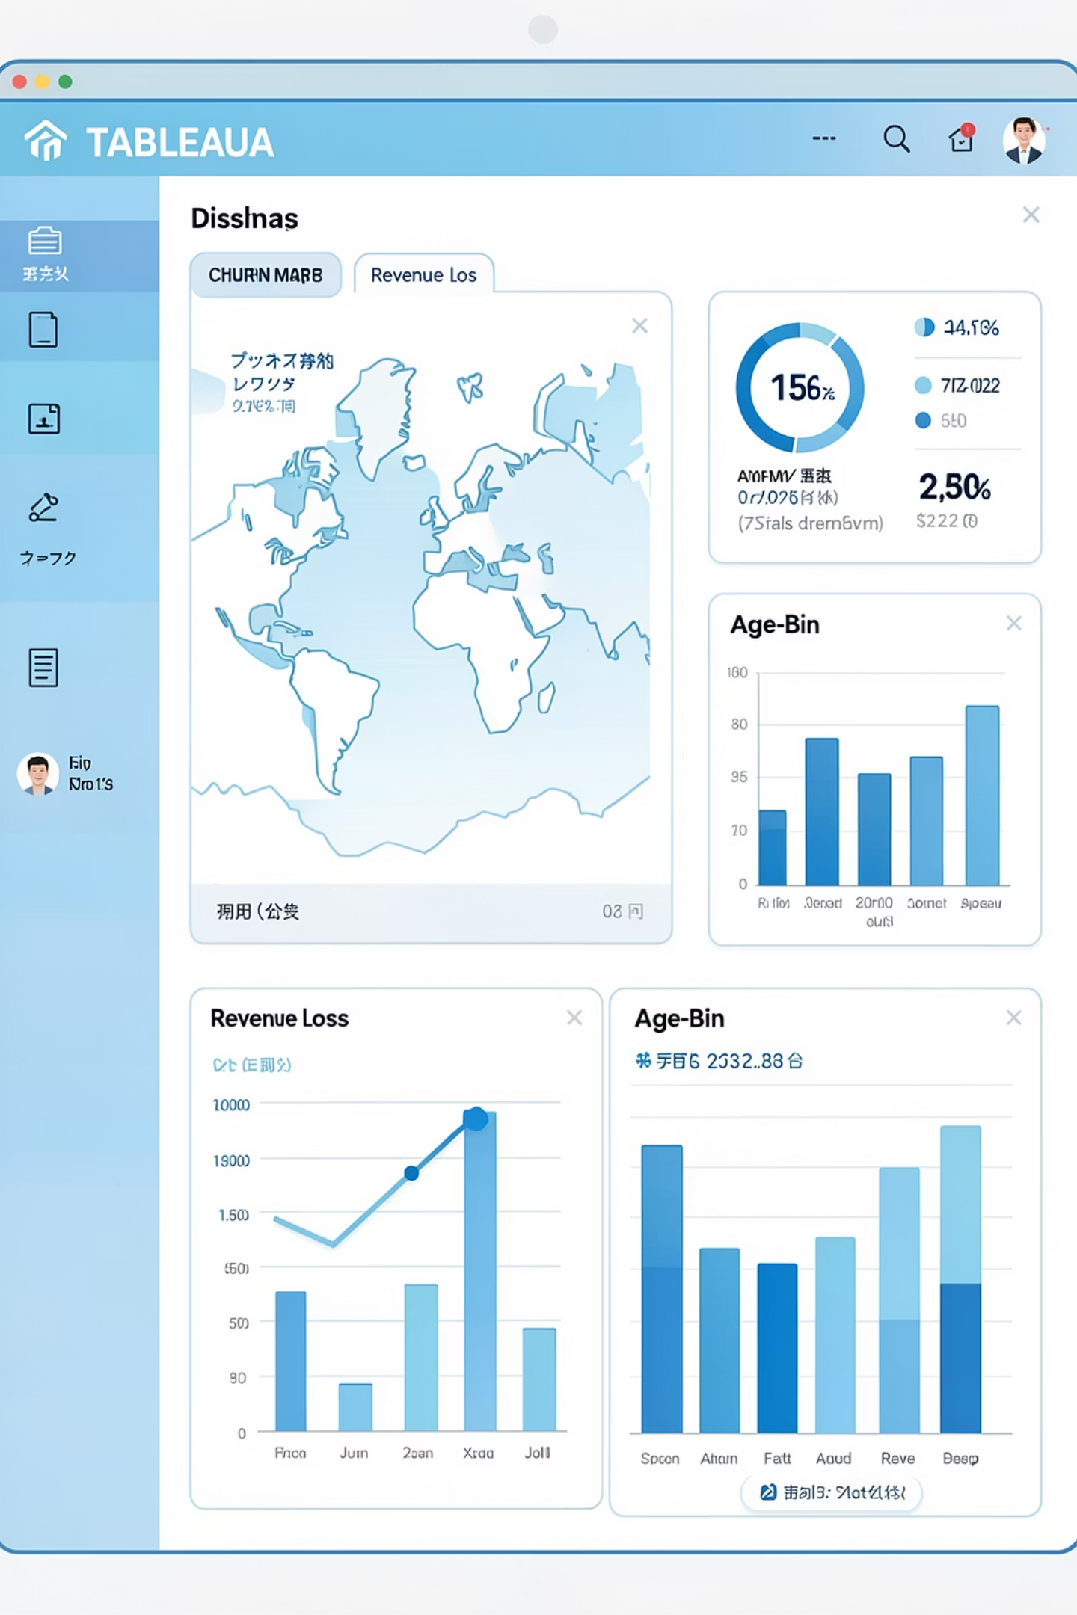
Final Dashboard Snapshot
Consolidated visual of churn hotspots, revenue attribution, and service-impact metrics to guide action planning.

Slide 10


Conclusion & Next Steps
Premium Tech Support is a key retention lever; bundle with Fiber plans.
Competitor activity accounts for $1.69M of $3.68M lost — prioritize win-back campaigns.
Convert month-to-month Fiber users (1,107 churners) with incentives.
Audit high-churn California regions to address local issues.
Author: J. Vijay — Final-year BBA, Osmania University · www.linkedin.com/in/jabu-vijay

